Slide 1

Gaussian Distribution, Skewness and Outliers
Professor Bo Liu
James Watt School of Engineering

Slide 2
Gaussian distribution
(a.k.a. normal distribution)
y
y
x
x
Gaussian distribution
Uniform distribution
Gaussian distribution observation:
Data near the mean are more frequent in occurrence than data far from the mean.

Slide 3

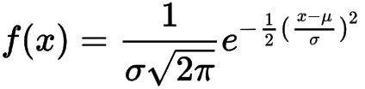
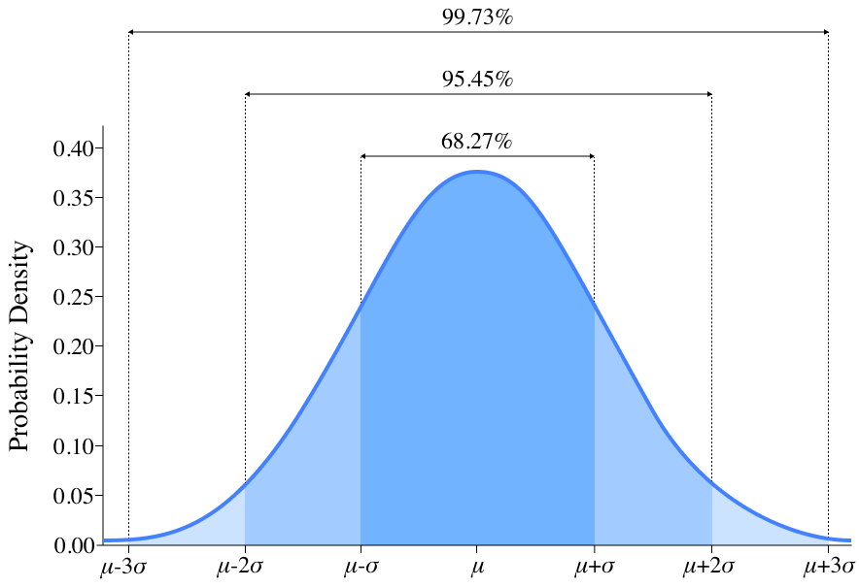
Gaussian distribution
(a.k.a. normal distribution)
Probability density function,
μ: mean
σ: standard deviation
Observation:
The probability distribution is symmetric about the mean.
Data near the mean are more frequent in occurrence than data far from the mean.

Slide 4
Skewness
skewness = zero
positive skewness
negative skewness
Observation:
Symmetrical distributions have zero skewness.
Negative skewness: the “tail” is longer on the left side.
Positive skewness: the “tail” is longer on the right side.
Gaussian distribution: symmetrical, zero skewness

Slide 5
Outliers
y
outlier
outlier
x
Outliers are data points that are far from other data points, and they can distort statistical results
How can outliers be automatically identified?

Slide 6




Thanks!
#UofGWorldChangers
@UofGlasgow

